Slide 1
Hospital Pharmacy Management system
Database

Slide 2
Hospital Pharmacy Management system
1
2
3
4
What is the solved business problem?
What is the database schema?
How did you solve the business problem?
The application GUI and functionality
5
6
7
The challenges that you solved and technologies that you learned during the project.
Conclusion and future work to improve your app.
The challenges that you did not solve.

Slide 3
What is the solved business problem?
Reduce costs
Improve productivity
Attract new customers
New facilities/Geo expansion

Slide 4
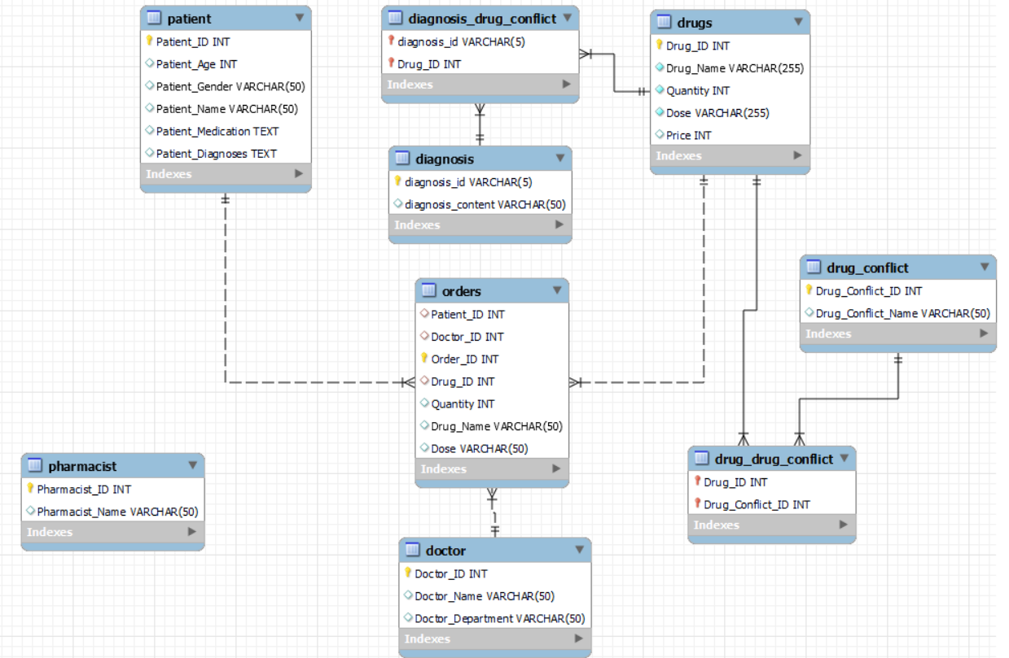
What is the database schema?

Slide 5
How did you solve the business problem?
Reduce Time
Reduce clicks
Ensure correctness
Medical Report

Slide 6
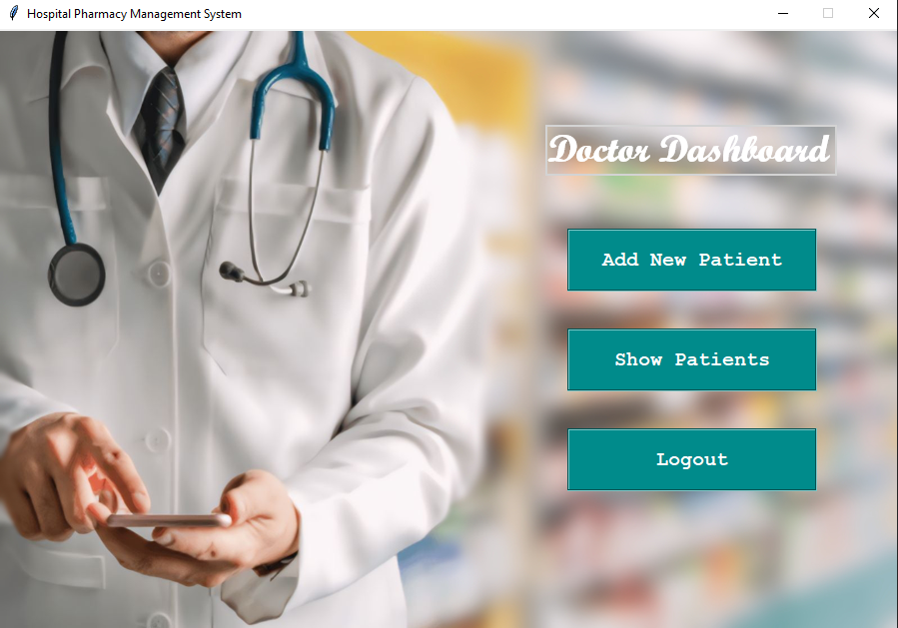
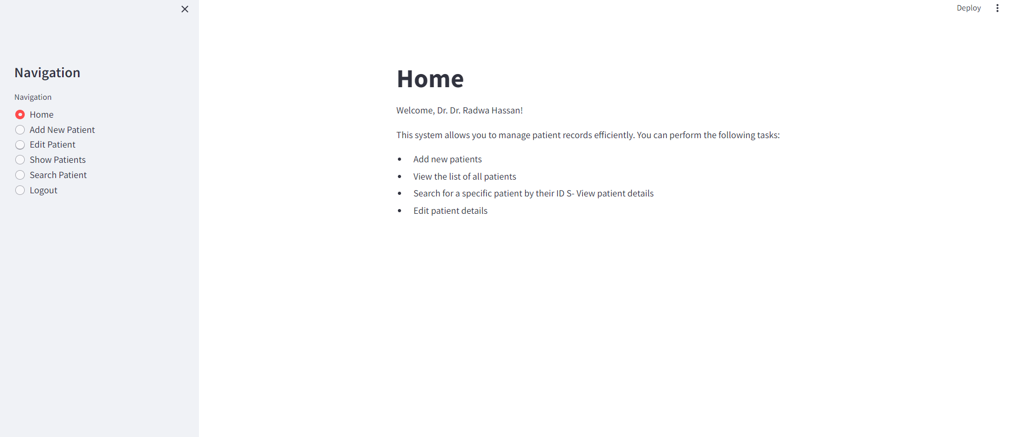
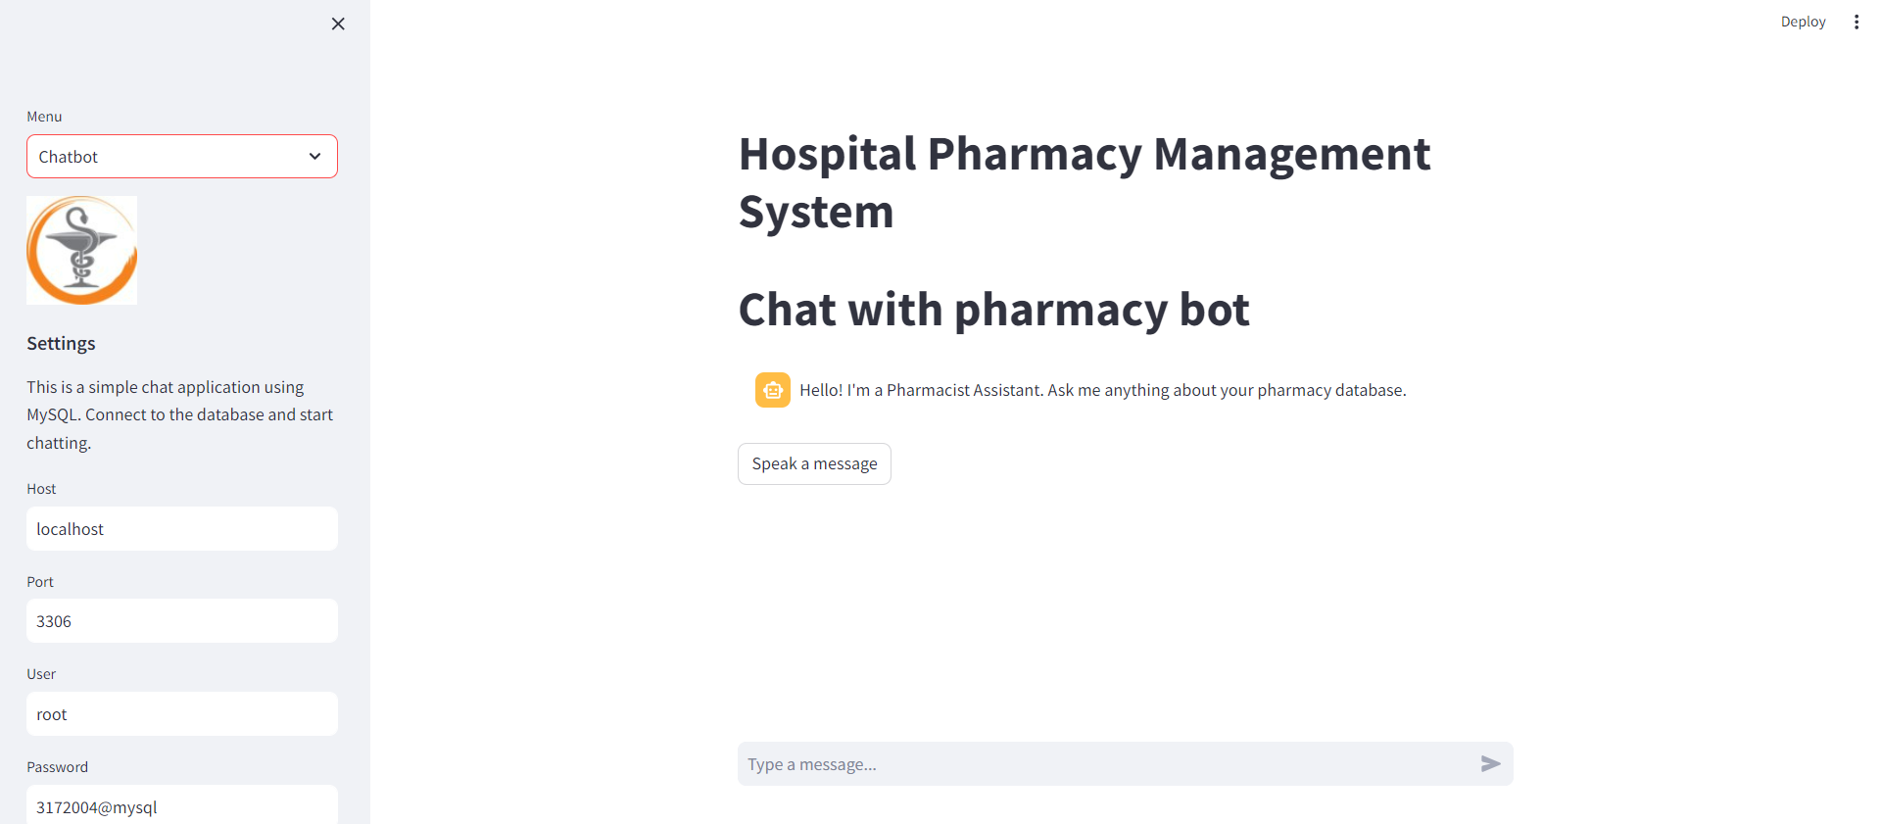
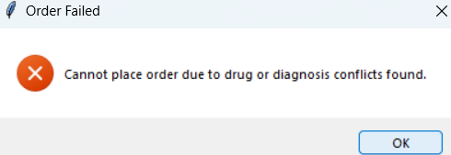
The application GUI and functionality
Tkinter
Streamlit
01
02
chatbot
Conflict
04
03

Slide 7
Challenges Solved
WorkFlow
Time Redunduncy
Conflcits

Slide 8
Challenges not solved Full Migration From Tkinter to Stremlit

Slide 9
Conclusion & Future Works
Data Risk
Interpretation Risk
Data Security
Data Quality
Model Risk
Interpretation Risk

